Slide 1

Strategic Ad Experience Optimization for Snapchat
Transforming Snapchat’s ad experience to boost engagement and revenue for 460M daily active users.
By Hardik Dave (Product Owner) & Shreyas Jondhale (Data Analyst)

Slide 2
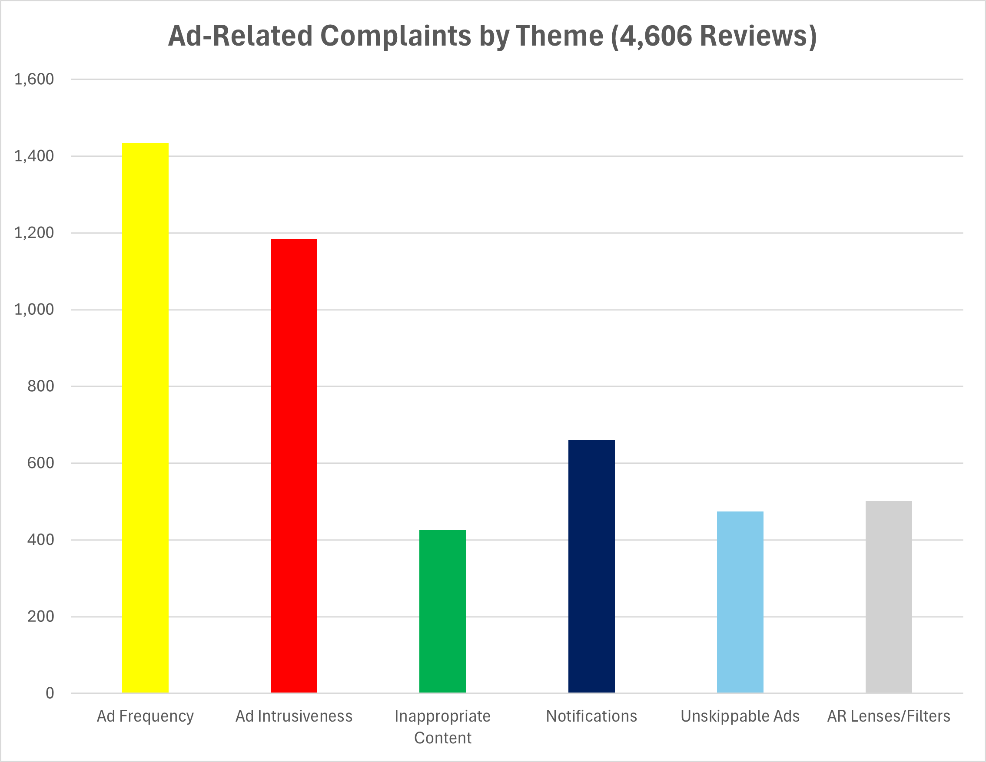
The Problem: Intrusive Ads Frustrate Users
Snapchat’s 460M daily active users (DAUs) face frequent ad interruptions, unskippable formats, and irrelevant AR filters, risking churn to competitors like Instagram.
41,287 Google Play reviews: 4,606 ad-related complaints (11.15%)
Key issues: Frequency (31.1%), Intrusiveness (25.7%), Inappropriate Content (9.2%)
Revenue at stake: $0.45B potential loss if not addressed

Slide 3
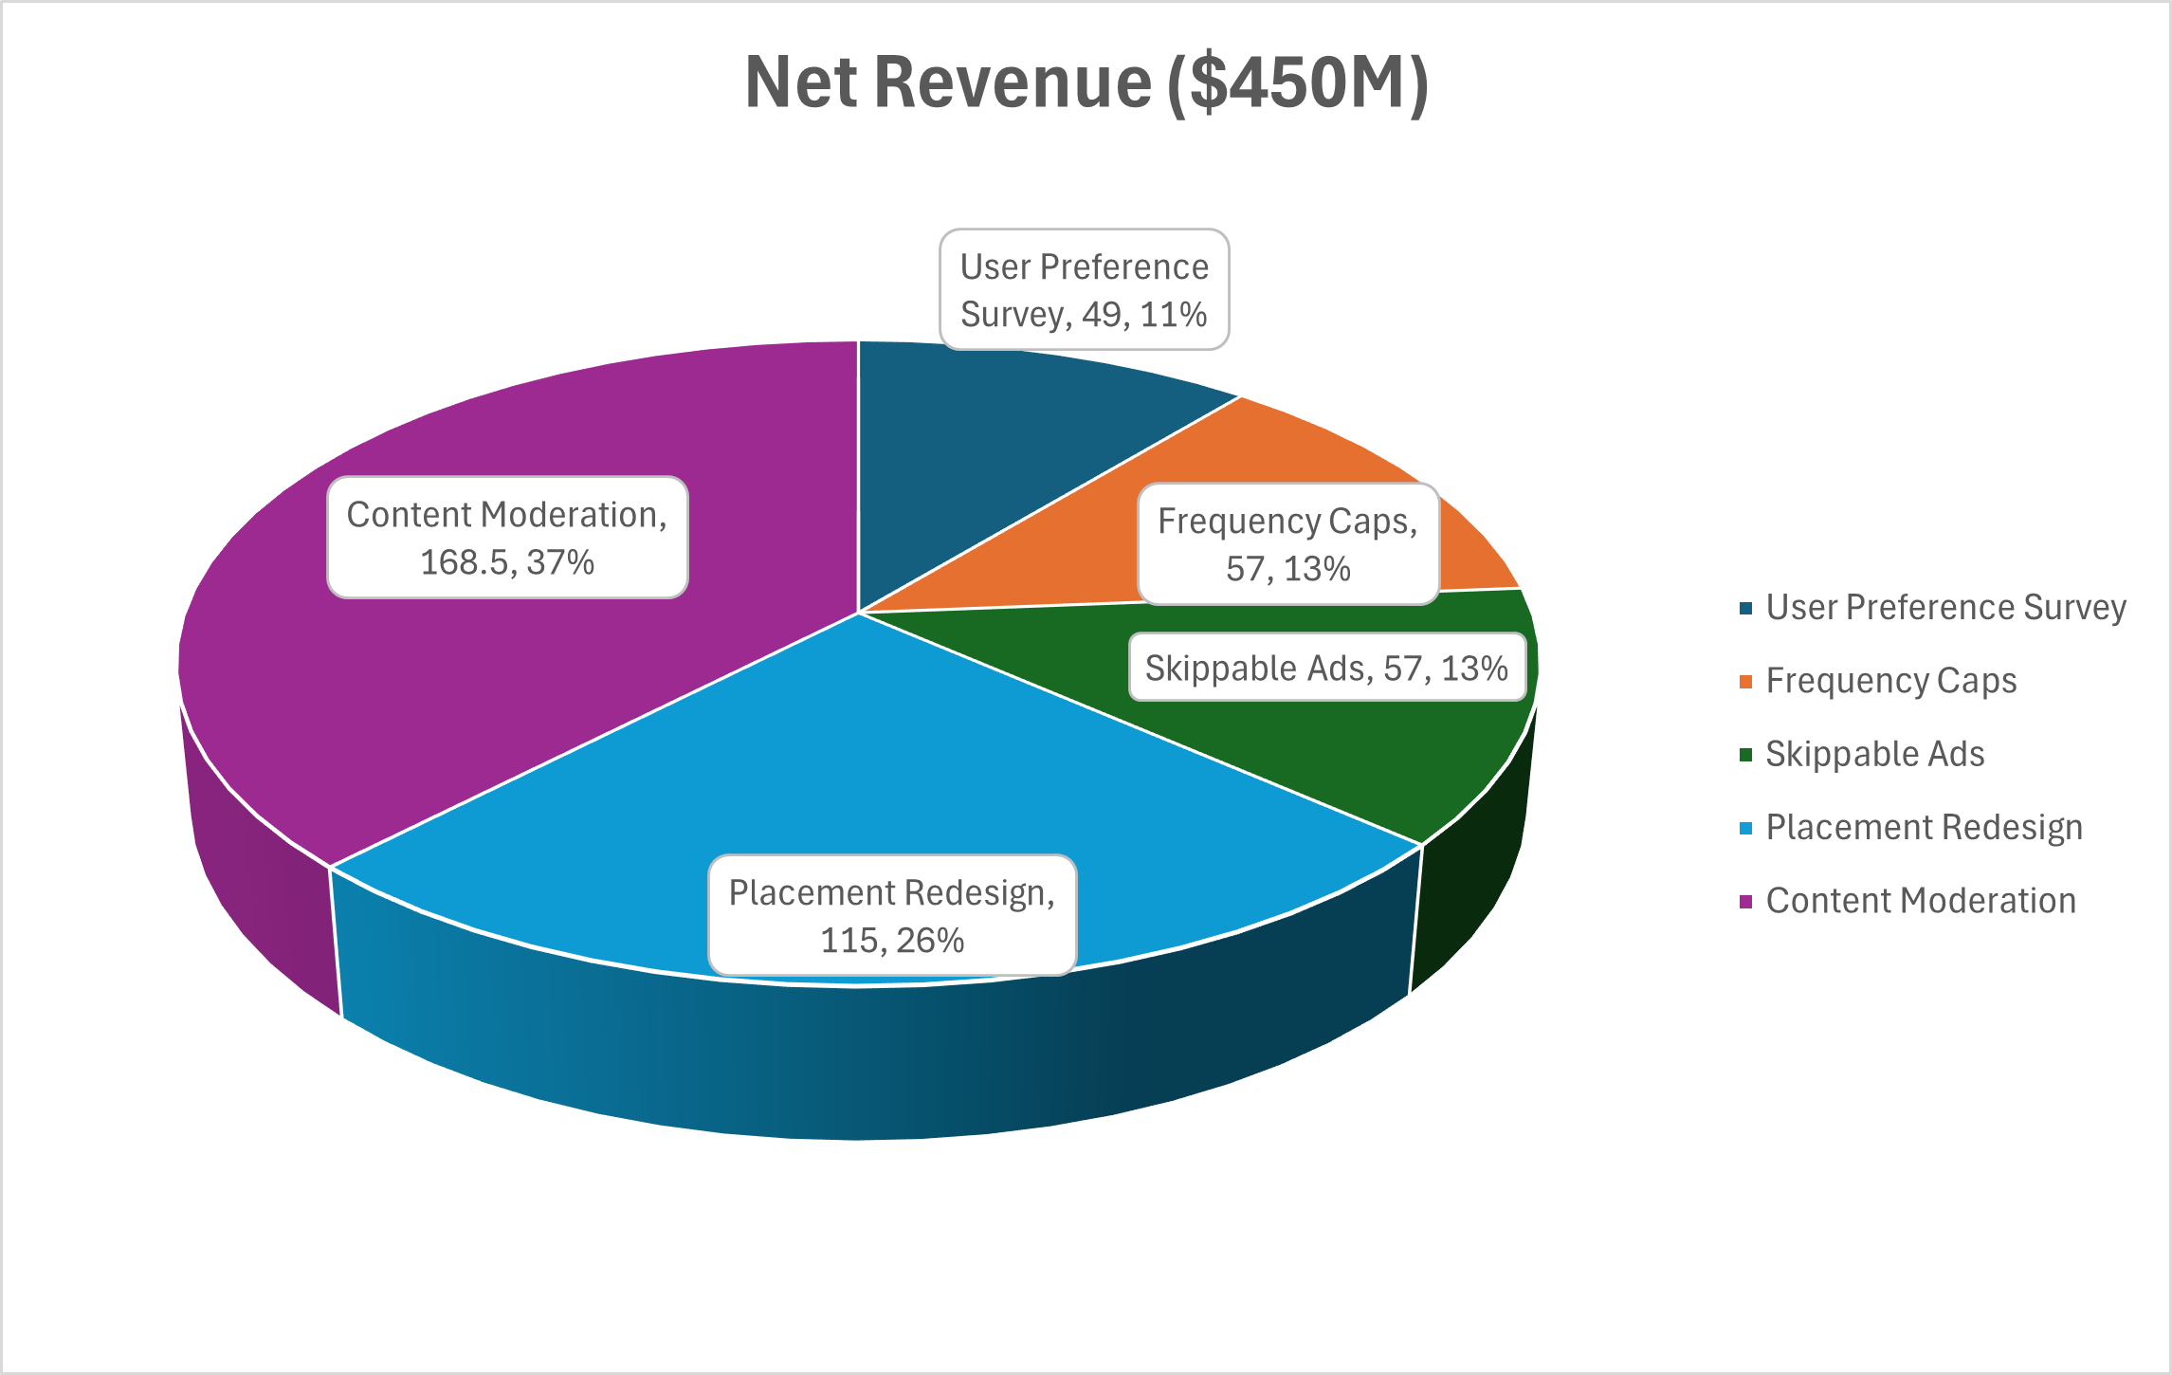
Five Solutions for Growth
User Preference Survey, Frequency Caps, Skippable Ads, Placement Redesign, and Content Moderation reduce complaints by 65%, enhance AR Lenses (6.4x swipe-to-purchase), and achieve 100x ROI.
Net revenue: $450M ($160–177M from Content Moderation).

Slide 4
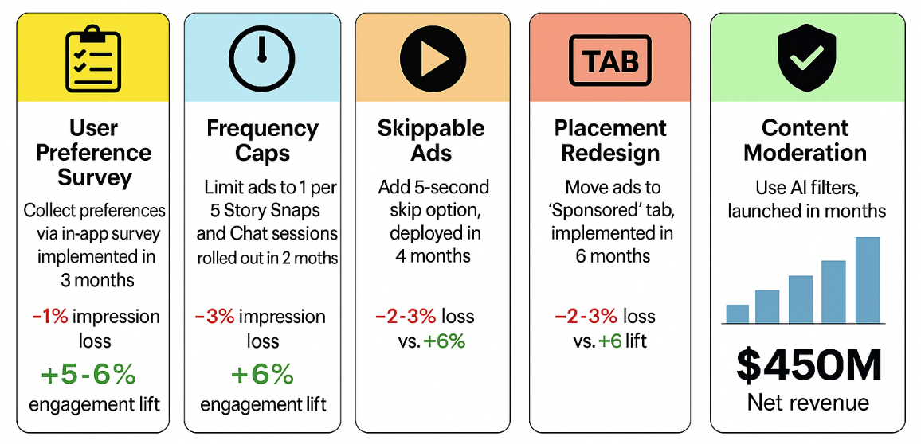
Implementation Plan
User Preference Survey: Collect preferences via in-app survey, implemented in 3 months with API integration. Trade-off: 1% impression loss vs. 5–6% engagement lift.
Frequency Caps: Limit ads to 1 per 5 Story Snaps and Chat sessions, rolled out in 2 months.
Trade-off: 3% impression loss vs. 6% lift.
Skippable Ads: Add 5-second skip option, deployed in 4 months.
Trade-off: 3% loss vs. 5% lift.
Placement Redesign: Move ads to 'Sponsored' tab, implemented in 6 months.
Trade-off: 2–3% loss vs. 6% lift.
Content Moderation: Use AI filters, launched in 8 months.
Trade-off: 2–3% loss vs. 8% lift.
Reduce complaints by 65%, enhance AR Lenses (6.4x swipe-to-purchase), and achieve 100x ROI.
Net revenue: $450M ($160–177M from Content Moderation).

Slide 5
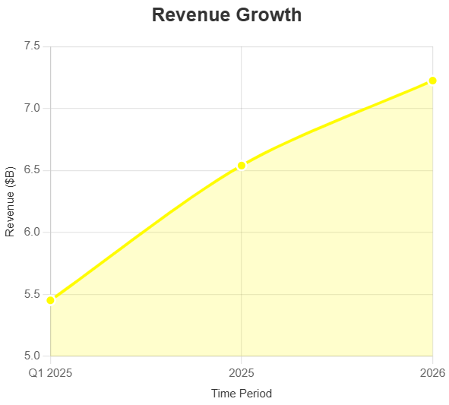
Financial Impact: 100x ROI
Total investment: $4.5M. Net revenue: $450M. ROI: 100x within 12 months.
Ad Revenue: $6.43–6.65B (2025), $7.09–7.36B (2026)
US Contribution: $3.12–3.23B (2025), $3.44–3.57B (2026)
User Retention: 320,000–552,000 users ($32–55M)

Slide 6
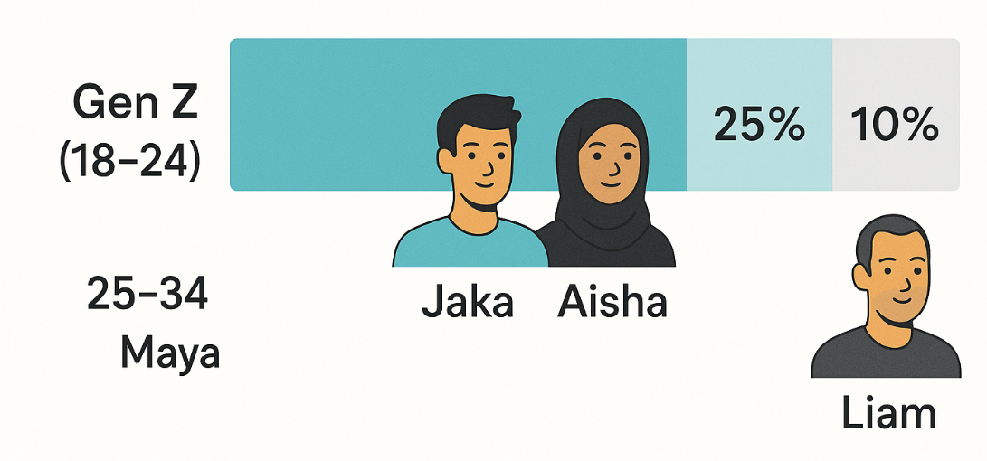
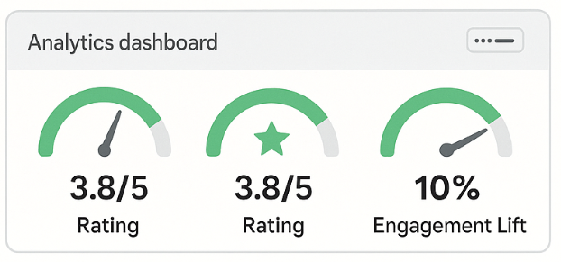
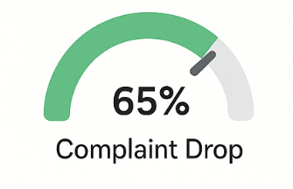
User Segments
Success Matrix

Slide 7
Let’s Collaborate!
Interested in the full strategy? Check out the detailed proposal posted alongside this PPT to explore the data, solutions, and projections for Snapchat’s ad optimization.
$450M net revenue potential.
100x ROI in 12 months.
Connect with us : dave.hard@northeastern.edu jondhale.s@northeastern.edu

